Slide 1

Tracing the arc
A Glimpse into the Past, Present, and Future of Artificial Intelligence
Dr. Edward Brash
A Lecture Series for the CNU Lifelong Learning Society
Fall 2023

Slide 2
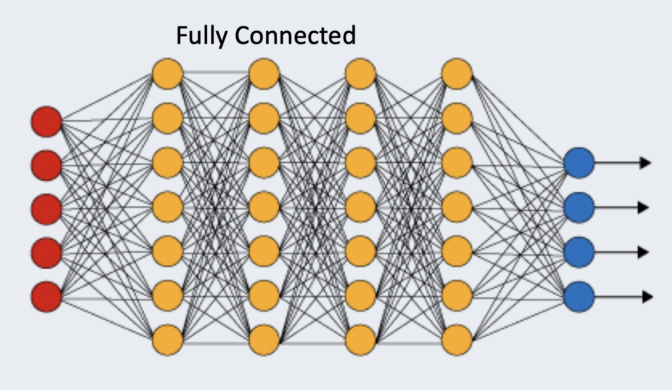
Deep Neural Networks
The red dots are the input data
The blue dots are the output results
The yellow dots are neurons
The lines joining things up represent the WEIGHTS in the model!!!!
Two interesting parameters in Neural Networks are:
The total number of neurons
The number of CONNECTIONS per neuron

Slide 3
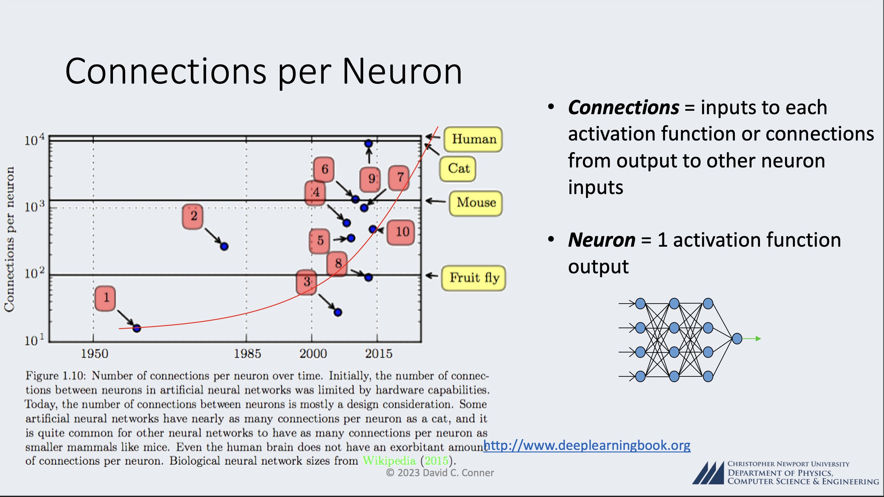

Slide 4
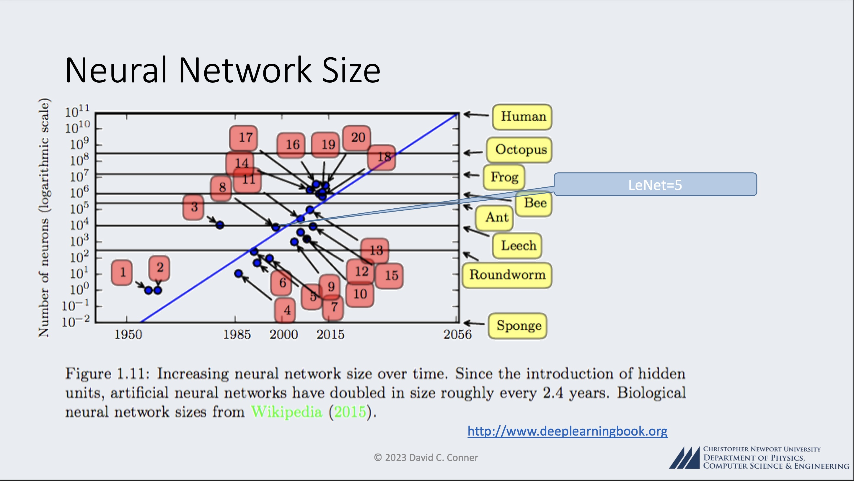

Slide 5
Applications of Deep Learning Neural Networks
Pioneering Models: Iconic models like LeNet-5, AlexNet, and VGGNet paved the way, demonstrating the potency of DLNNs in image classification tasks, notably in competitions like the ImageNet Large Scale Visual Recognition Challenge (ILSVRC).
Applications: DLNNs have permeated diverse domains, including:
medical image analysis
computer vision in autonomous vehicles
facial recognition, and more, any image-related ML task
Natural Language Processing (NLP): Deep learning, particularly models like Recurrent Neural Networks (RNNs) and Transformers, has revolutionized NLP, enabling machines to understand, generate, and translate human languages with unprecedented proficiency.

Slide 6
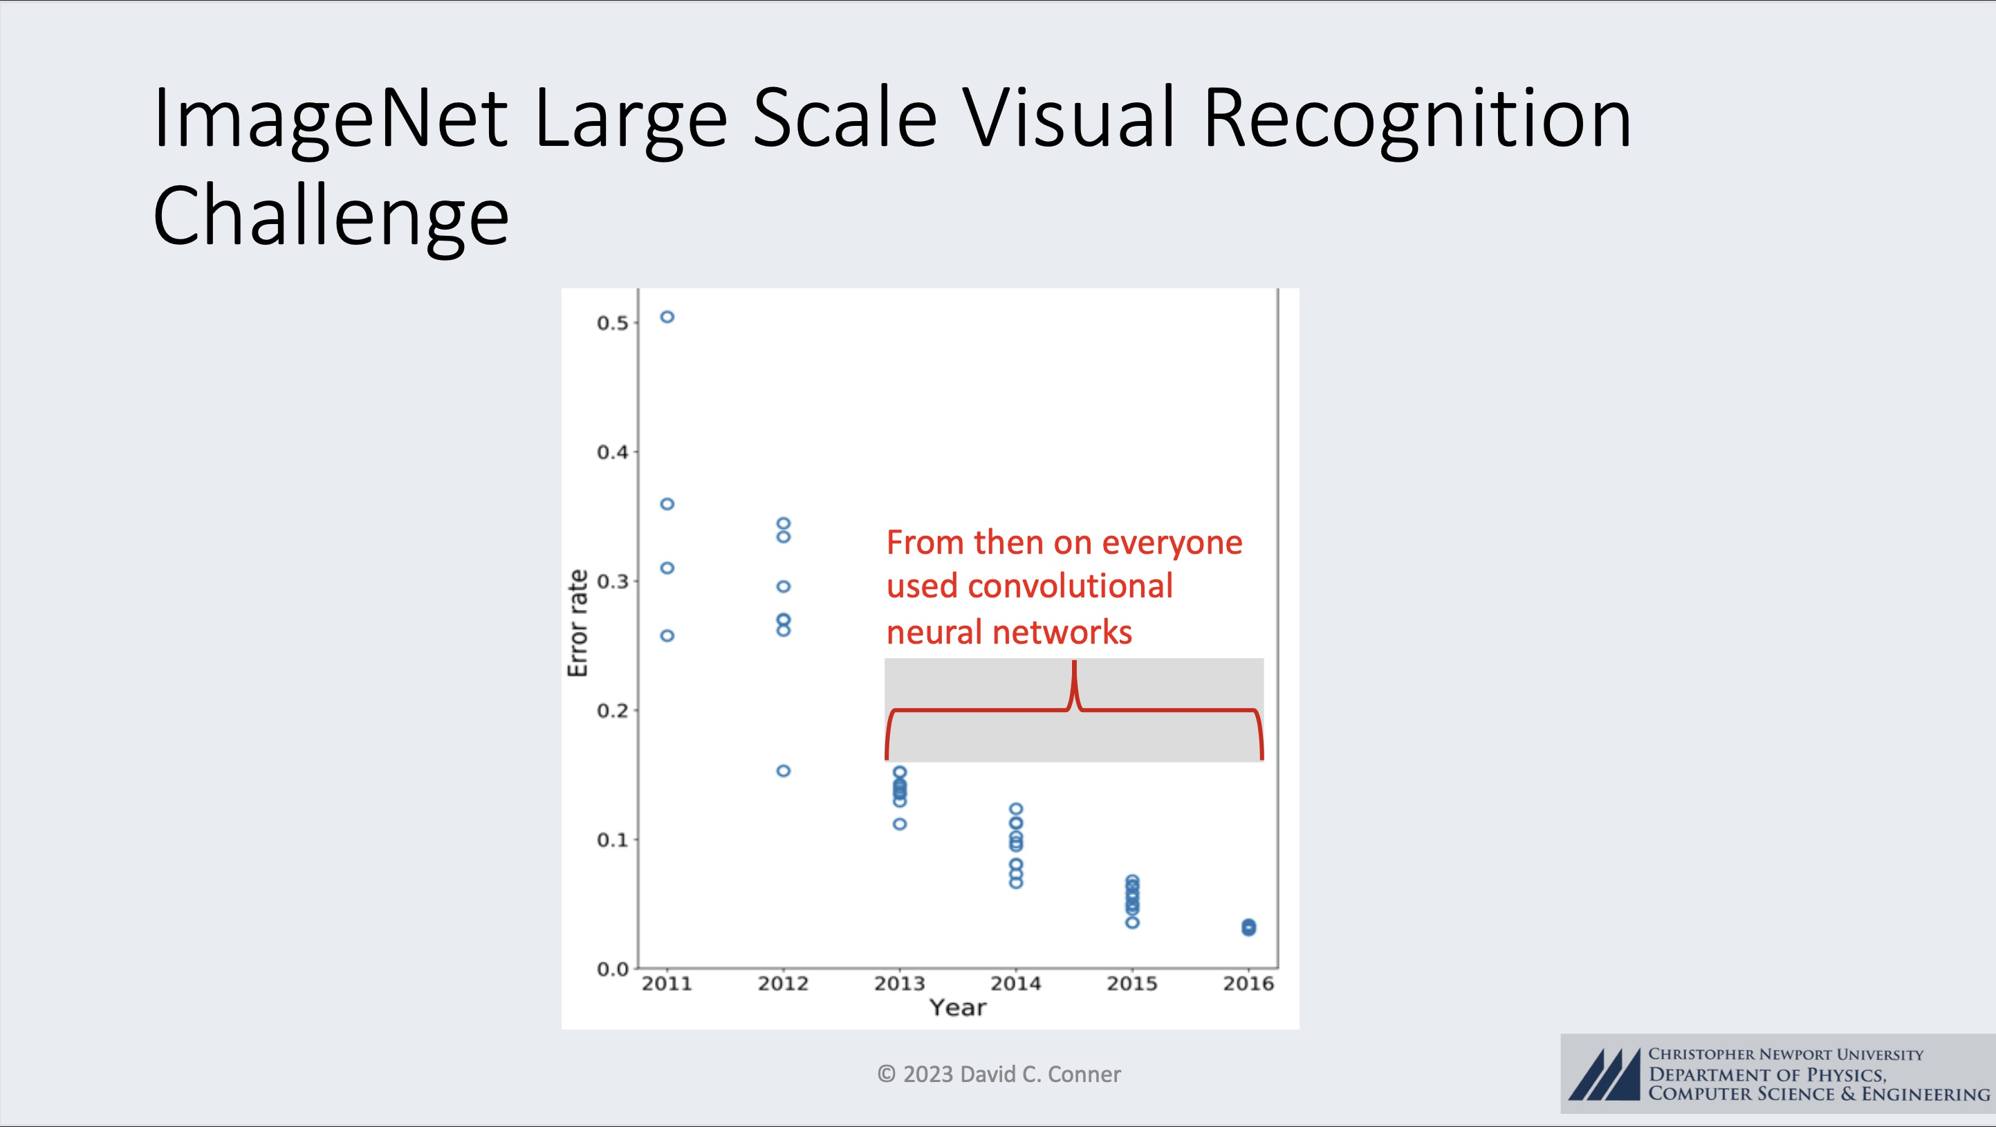
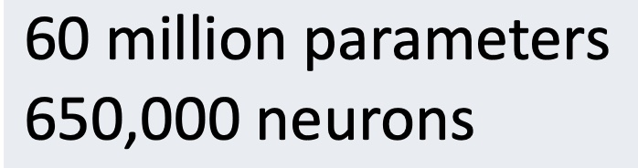
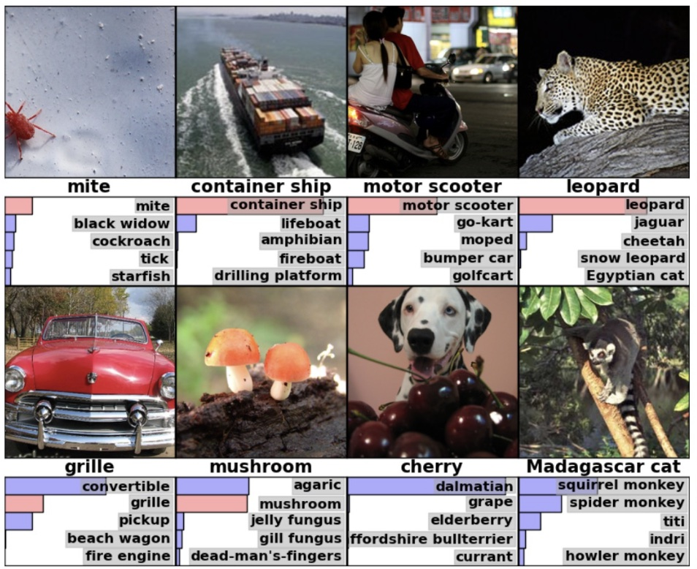

Slide 7
Applications of Deep Learning Neural Networks
Pioneering Models: Iconic models like LeNet-5, AlexNet, and VGGNet paved the way, demonstrating the potency of DLNNs in image classification tasks, notably in competitions like the ImageNet Large Scale Visual Recognition Challenge (ILSVRC).
Applications: DLNNs have permeated diverse domains, including:
medical image analysis
computer vision in autonomous vehicles
facial recognition, and more, any image-related ML task
Natural Language Processing (NLP): Deep learning, particularly models like Recurrent Neural Networks (RNNs) and Transformers, has revolutionized NLP, enabling machines to understand, generate, and translate human languages with unprecedented proficiency.

Slide 8
Conclusions, at this point …
Deep Learning Neural Network Artificial Intelligence Engines can, in the present day, do AMAZING THINGS!!!
Many (most?) of these things HELP HUMANITY
With that said (and I believe it to be true), there are aspects of the implementation and regulation of this technology where there exist very real and very concerning ethical and societal concerns.

Slide 9
Ethical and Societal Concerns
Bias: Pervasive and Perilous
Manifestation and Origins – Two BIG Problem Areas!!!
Data-Driven Bias: Historical data, often used to train AI models, might embed existing prejudices and inequalities, perpetuating and sometimes exacerbating them when the AI is deployed.
Algorithmic Bias: Even with unbiased data, algorithmic design and decision-making frameworks can inadvertently introduce bias, favouring certain outcomes or groups.
In some cases, these two areas can overlap with one another, to produce some very worrying applications of AI.

Slide 10
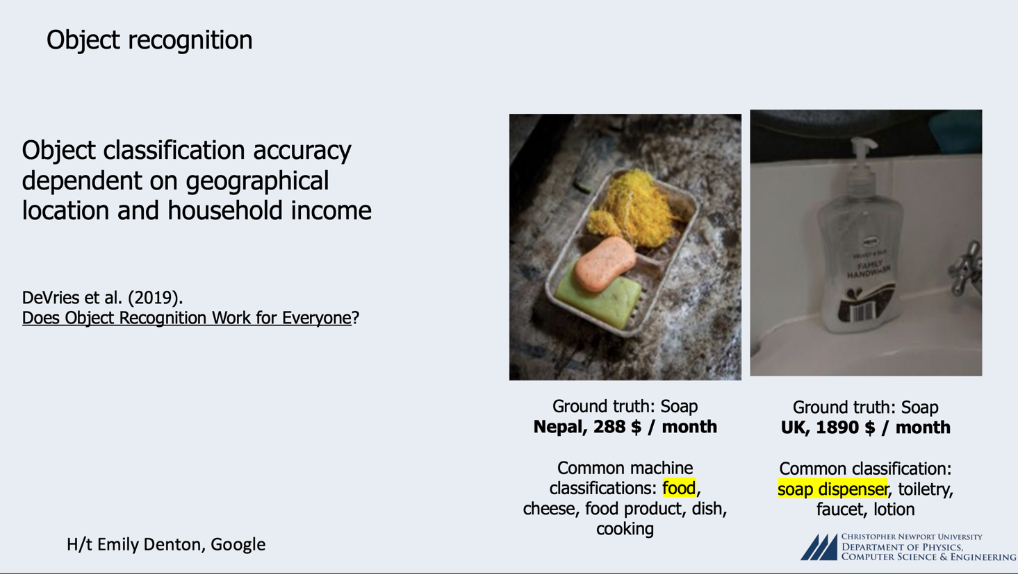

Slide 11
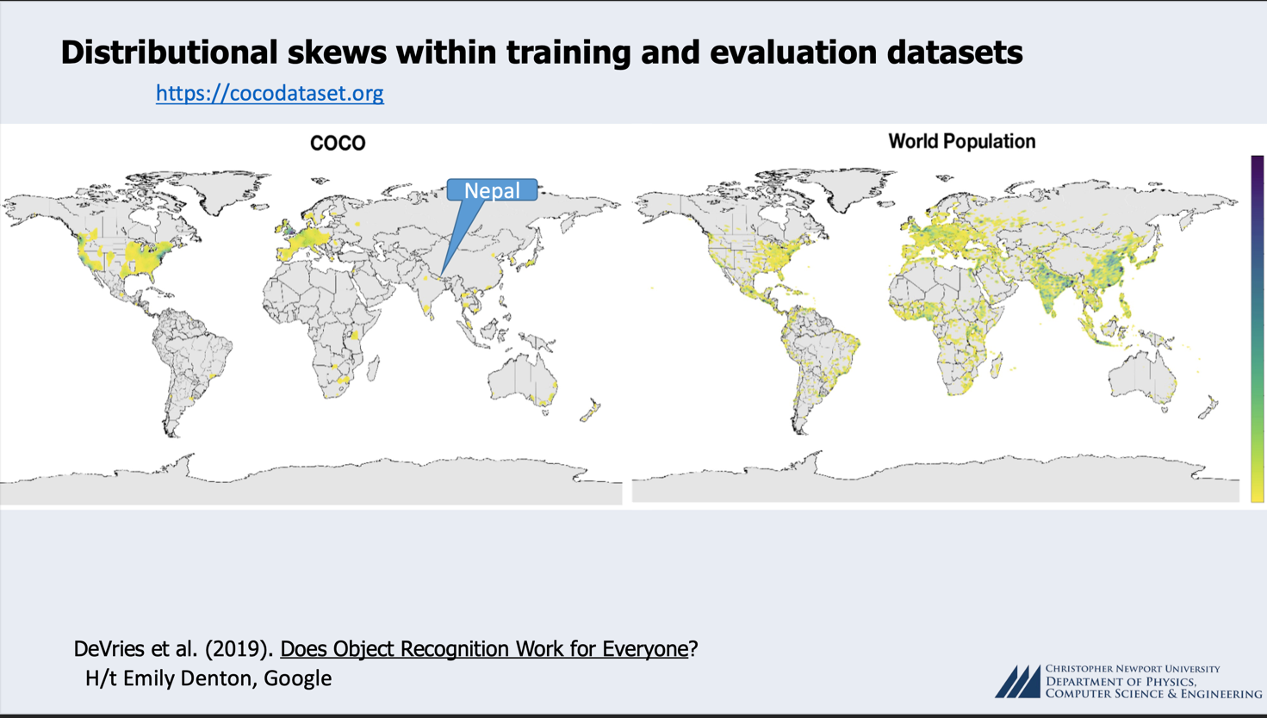

Slide 12


Slide 13
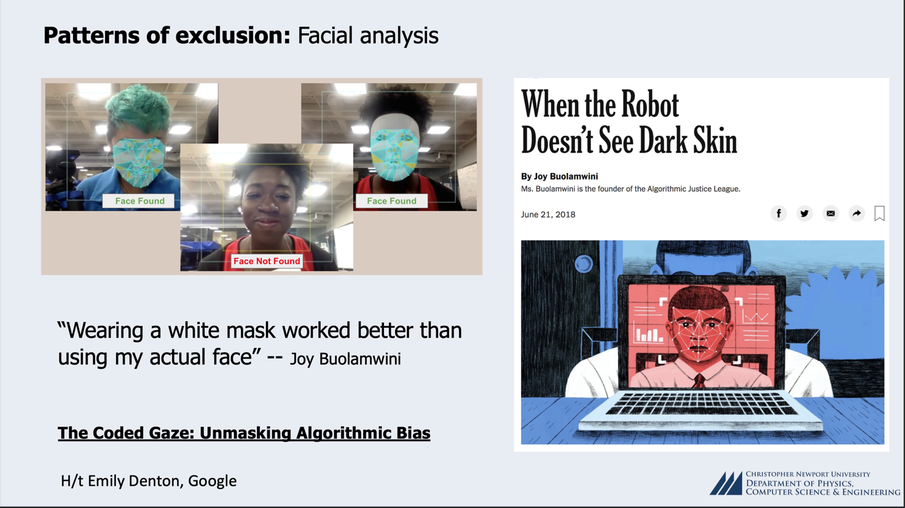

Slide 14
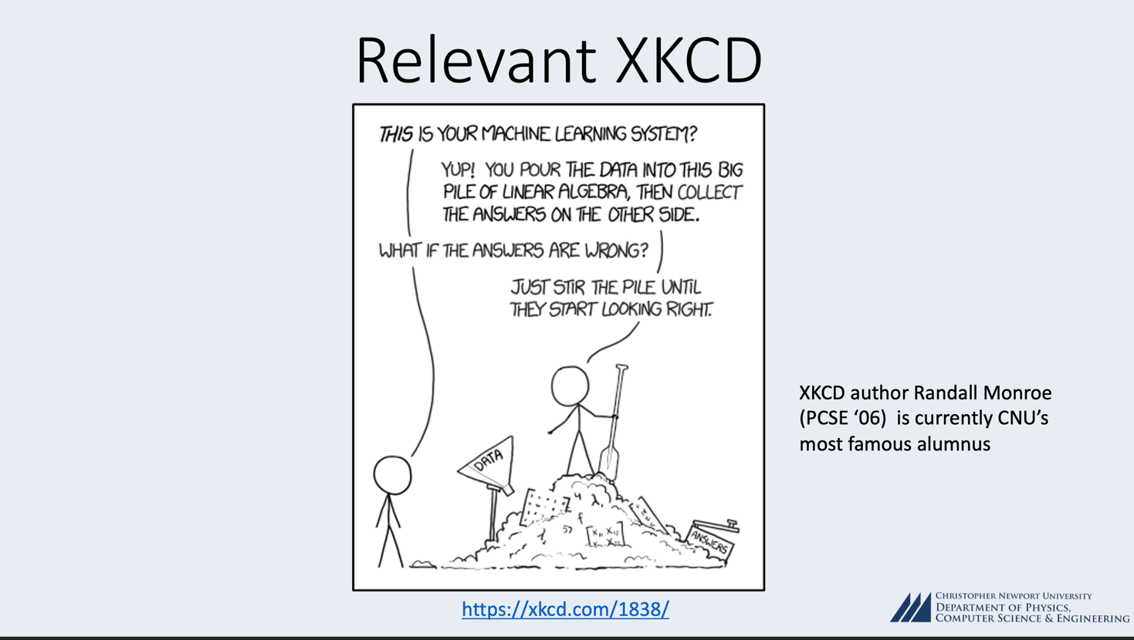

Slide 15
Data Problems
Implications
Inequality Propagation: Biased AI can perpetuate and amplify existing disparities, making existing inequities more entrenched.
Mitigations
Auditing and Oversight: Employing rigorous audits to ensure that models do not perpetuate bias and are fair in their decisions.
Diverse and Representative Data: Ensuring that training data is representative of the diverse populations it will impact, mitigating skewed learning.

Slide 16
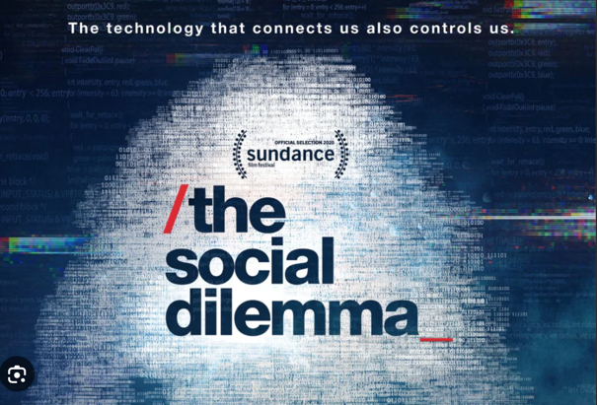

Slide 17
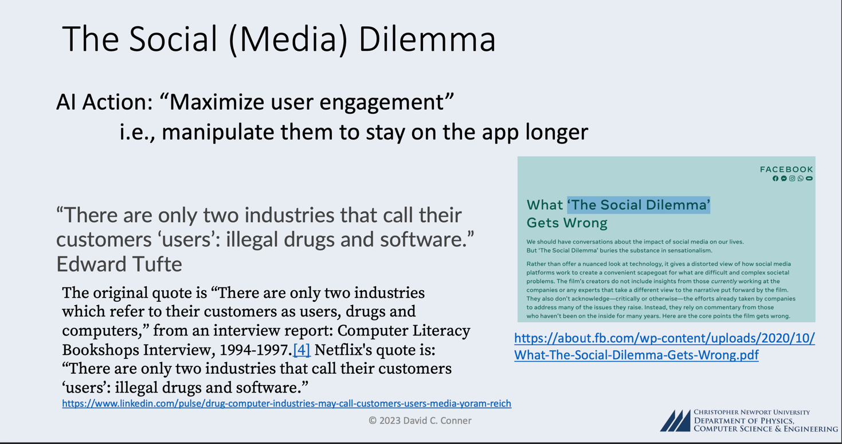

Slide 18
Algorithmic Bias
Ad management and optimization:
“AI-powered tools can help analyze hundreds or thousands of ads, targeting, and budget variations, find and segment audiences, make ads creative, test ads and improve speed and performance in real time to get the best results.” – Forbes Magazine (business focus)
The possibility of algorithmic bias, which may result in the unjust treatment of particular groups of individuals, is one of the major issues.
Additionally, the rapid technological advancement means that regulatory frameworks and ethical guidelines still have to catch up, leaving AI developers and social media companies to confront complex ethical and legal issues alone.

Slide 19
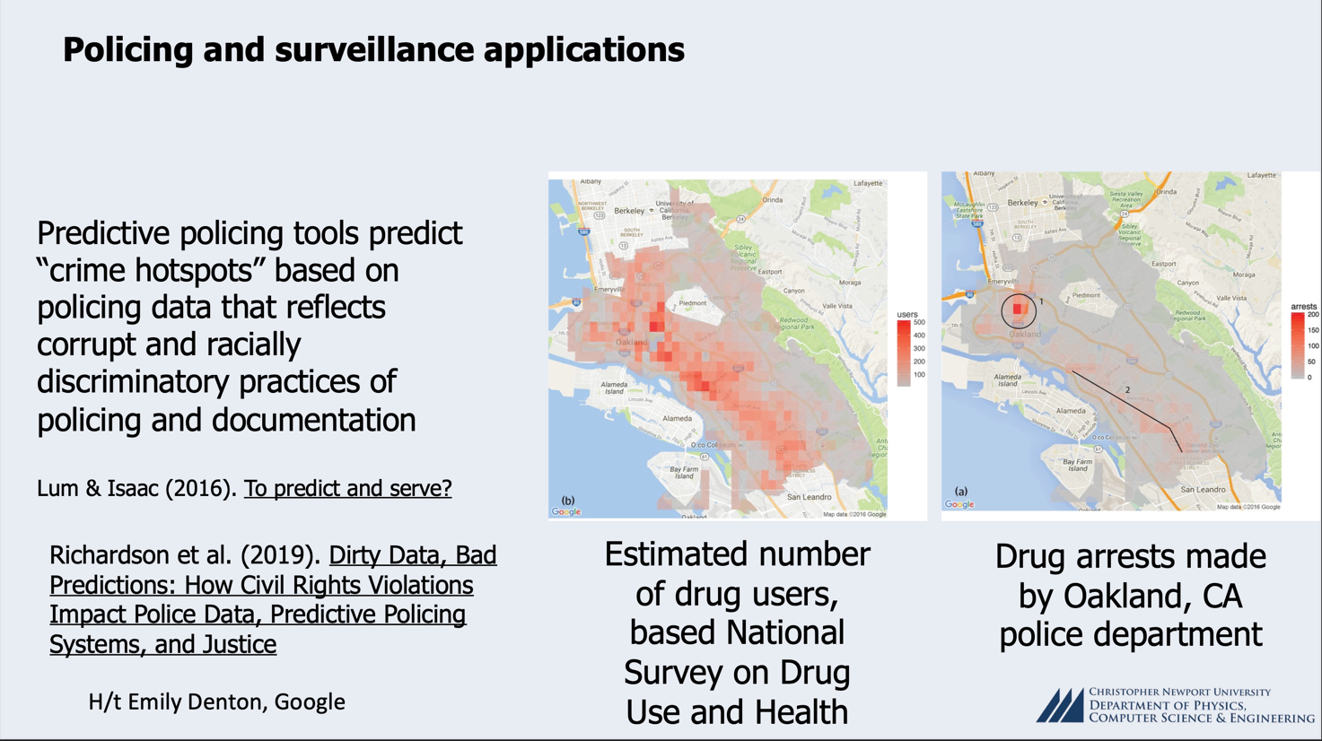

Slide 20
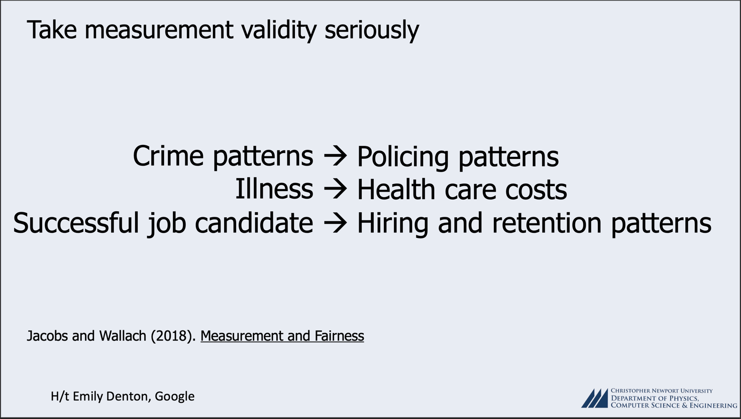

Slide 21

Bayesian Inference
Question: Does alcoholism lead to cirrhosis of the liver?

Slide 22
Bayesian Inference
Question 1: What is the probability that if a person is an alcoholic that will develop liver disease? … these are the people that WE interact with, on a daily basis
Question 2: What is the probability that if a person has liver disease that they are an alcoholic? … these are the people that liver disease DOCTORS interact with, on a daily basis
These are two DIFFERENT questions, and the answers (i.e. the probabilities) are NOT the same!!!!!!!!!!!!!!!!!

Slide 23
Bayesian Inference
P (alcoholic | liver disease) = ?
P (liver disease | alcoholic ) = ?
P (liver disease) = ?
P (alcoholic) = ?

Slide 24
Bayesian Inference
P (liver disease | alcoholic) = ? …. I don’t have any idea … it’s a PREDICTION for the future!!!!
P (alcoholic | liver disease) = ? … let’s get that from liver disease doctors … it’s really high … like 85%
P (liver disease) = ? … let’s look that up on Google … it’s about 1 in 400, or 0.25%
P (alcoholic) = ? … let’s look that up on Google … it’s about 6%

Slide 25
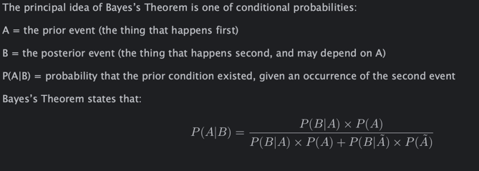
Bayesian Inference
We can use Bayes’s Theorem to calculate the future probability!!!

Slide 26
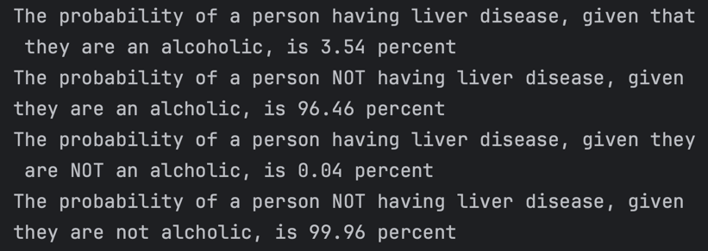
Bayesian Inference

Slide 28
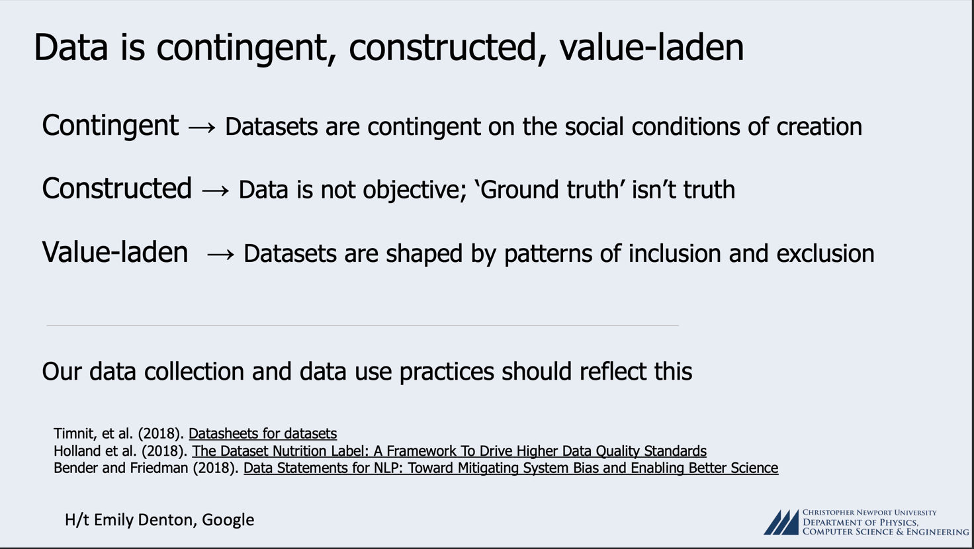

Slide 29
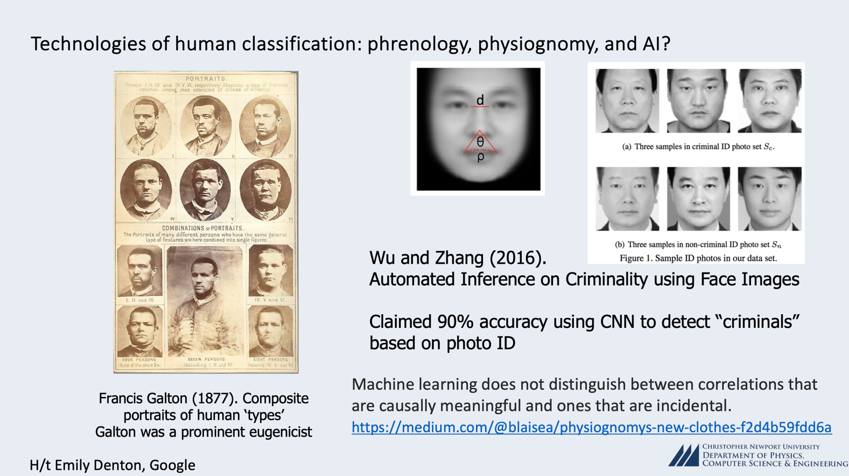

Slide 30
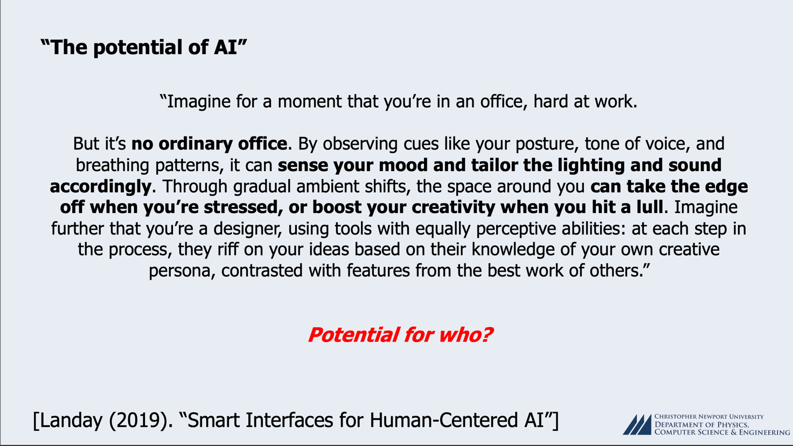

Slide 31
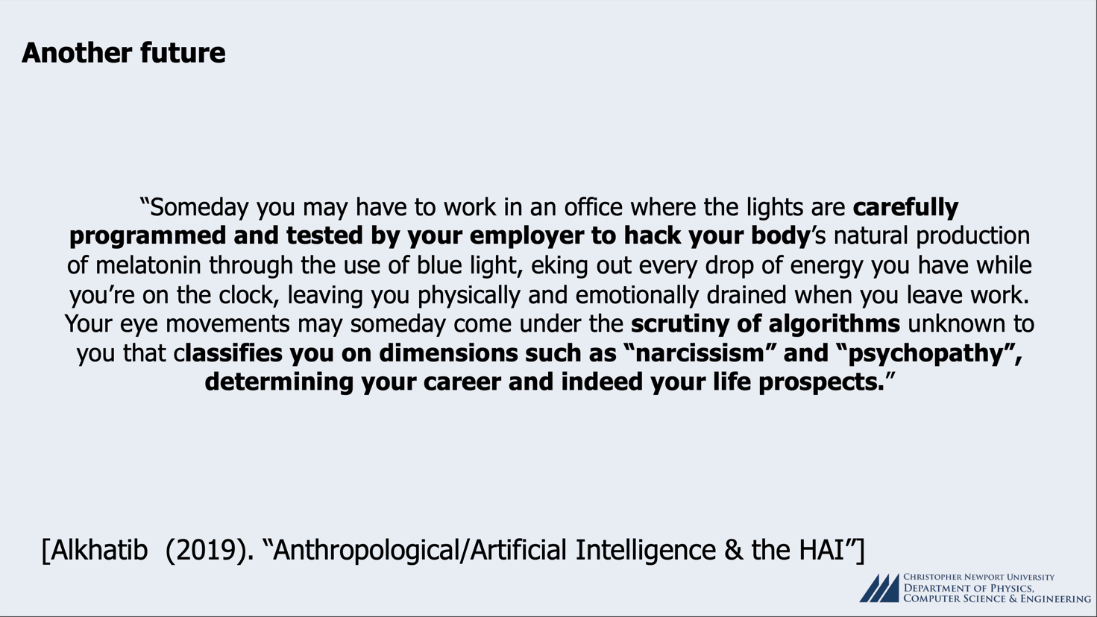

Slide 32
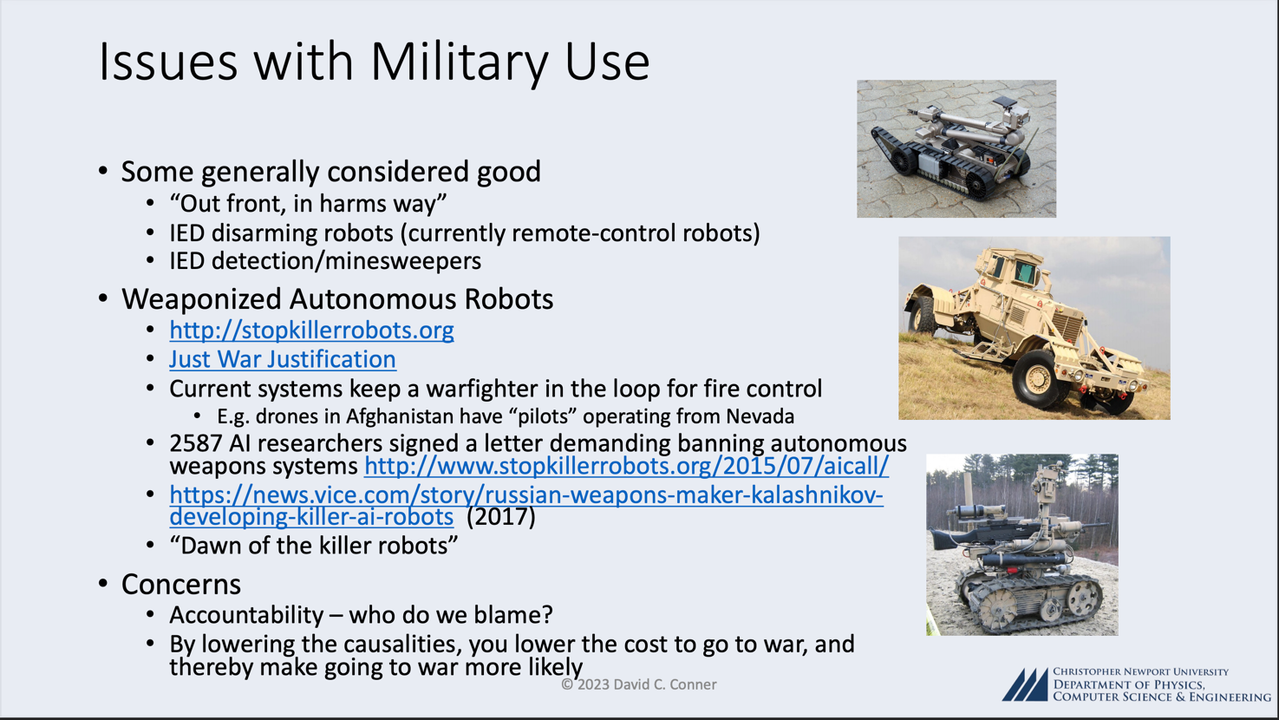

Slide 33
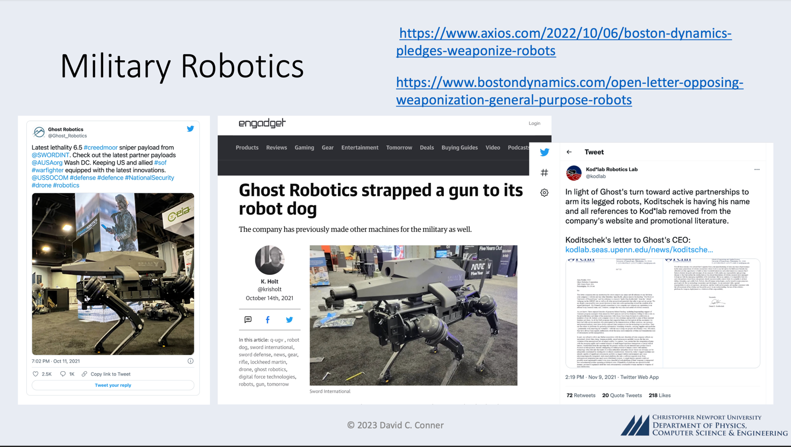

Slide 34
So, where does that leave us?
Accountability: Determining Responsibility in Autonomous Decision-making
Challenges
Attribution of Blame: In scenarios where AI-driven processes cause harm or make erroneous decisions, establishing accountability becomes intricate due to the autonomous nature of the technology.
Legal and Ethical Time Lag: Existing legal and ethical frameworks often fall short of effectively addressing the autonomous and complex nature of AI systems.

Slide 35
Where do we go from here?
Strategies
Transparent Decision Pathways: Developing and employing algorithms that provide clear, understandable explanations for their decisions, ensuring that stakeholders can comprehend and challenge them.
Robust Legal Frameworks: Establishing comprehensive legal frameworks that anticipate and address the multifaceted challenges posed by autonomous systems.
Transparency: Demystifying Algorithmic Operations
Trust Building: Transparency is pivotal in establishing trust among end-users, stakeholders, and society at large.
Ethical Compliance: Ensuring that the internal workings of algorithms align with ethical norms and societal values.

Slide 36
Where do we go from here?
Advancements
Explainable AI (XAI): Techniques and models that prioritize creating comprehensible and interpretable AI, elucidating how algorithms arrive at specific decisions.
Transparency Regulations: Establishing regulations that mandate certain levels of transparency, ensuring that algorithms can be scrutinized, understood, and regulated.
Many regulatory agencies have started this work, including the U.S. Federal Trade Commission’s (FTC) Office of Technology and Consumer Financial Protection Bureau (CFPB), new algorithmic regulators in the Netherlands and Spain, and online platform regulators such as the UK’s Office of Communications (OFCOM) and the European Centre for Algorithmic Transparency. These agencies and others have started to implement novel approaches and policies for AI regulation.

Slide 37
Tracing the arc
A Glimpse into the Past, Present, and Future of Artificial Intelligence
Dr. Edward Brash
A Lecture Series for the CNU Lifelong Learning Society
Fall 2023

